Slide 1
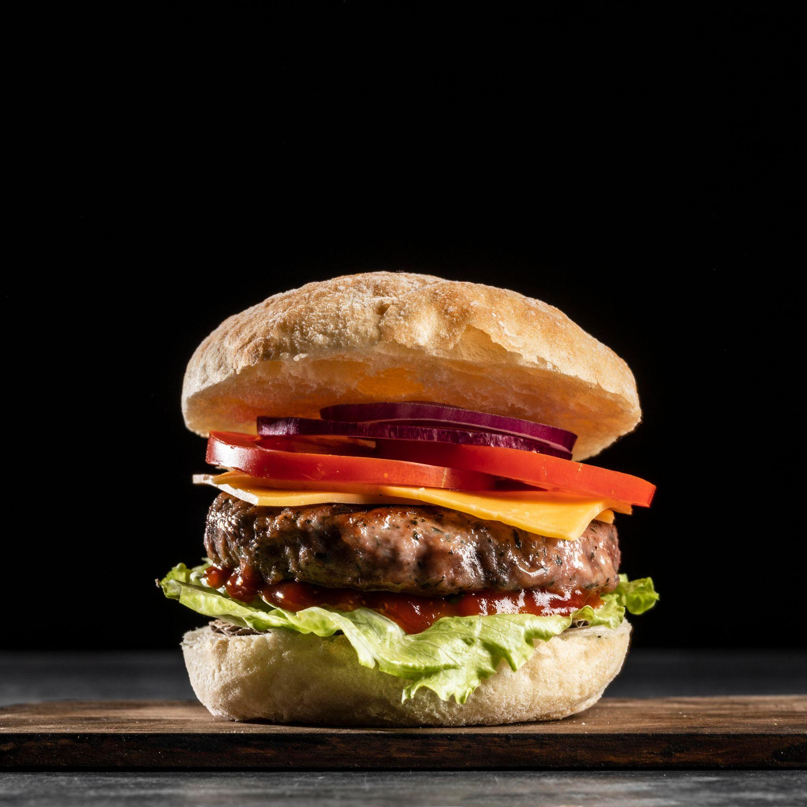
Fast Food Restaurant
Shanag ismael - Meer salam - Gazo badran

Slide 2
contents
01
02
03
04
05
06
SQL table
Data
Time
Rest
PDF
look and feel windows 11

Slide 3

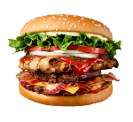

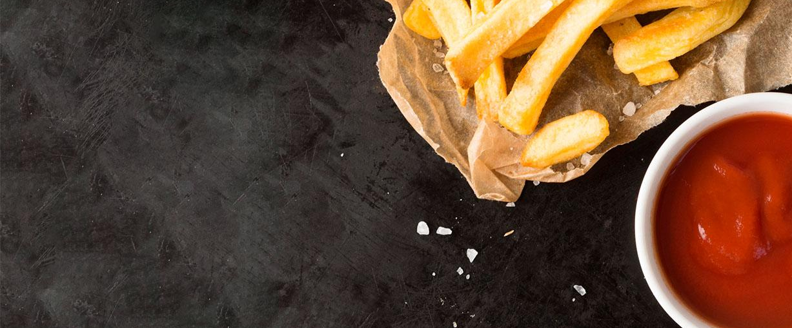

SQL Table :
01
_{customers}
_{Menu}

Slide 4
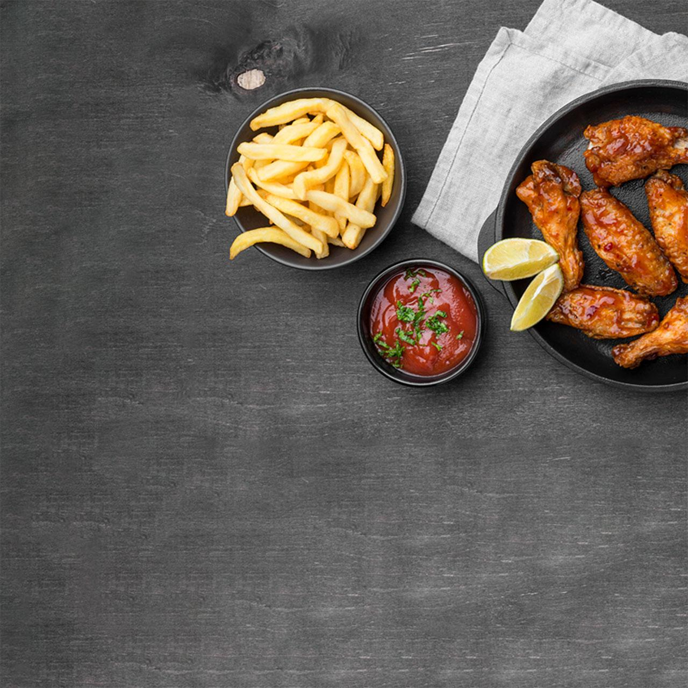
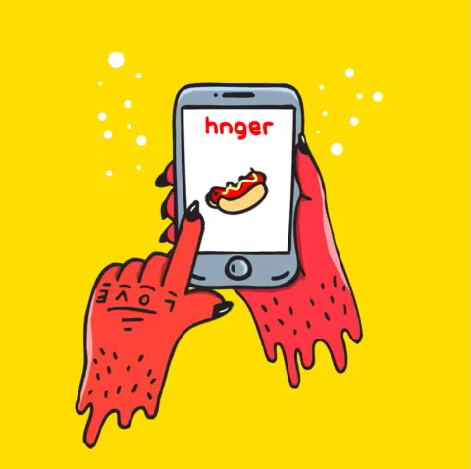
02
Data

Slide 5
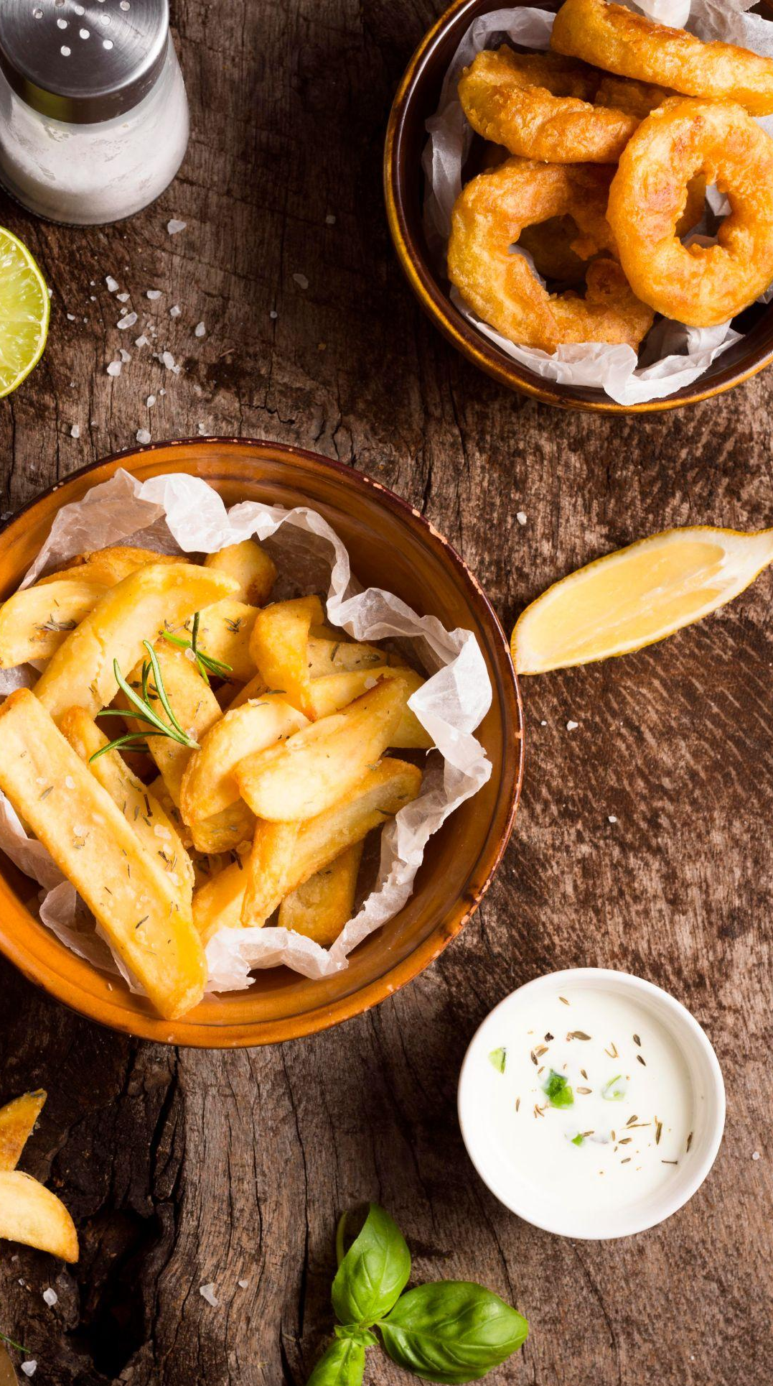
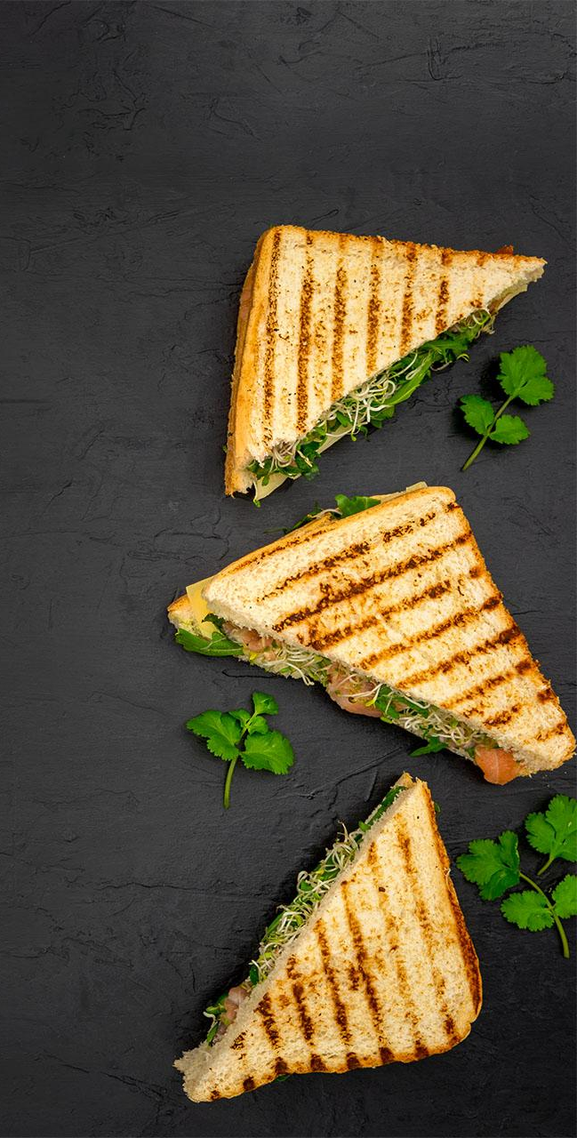
03
Time
5/17/2023 9:23:50 AM

Slide 6
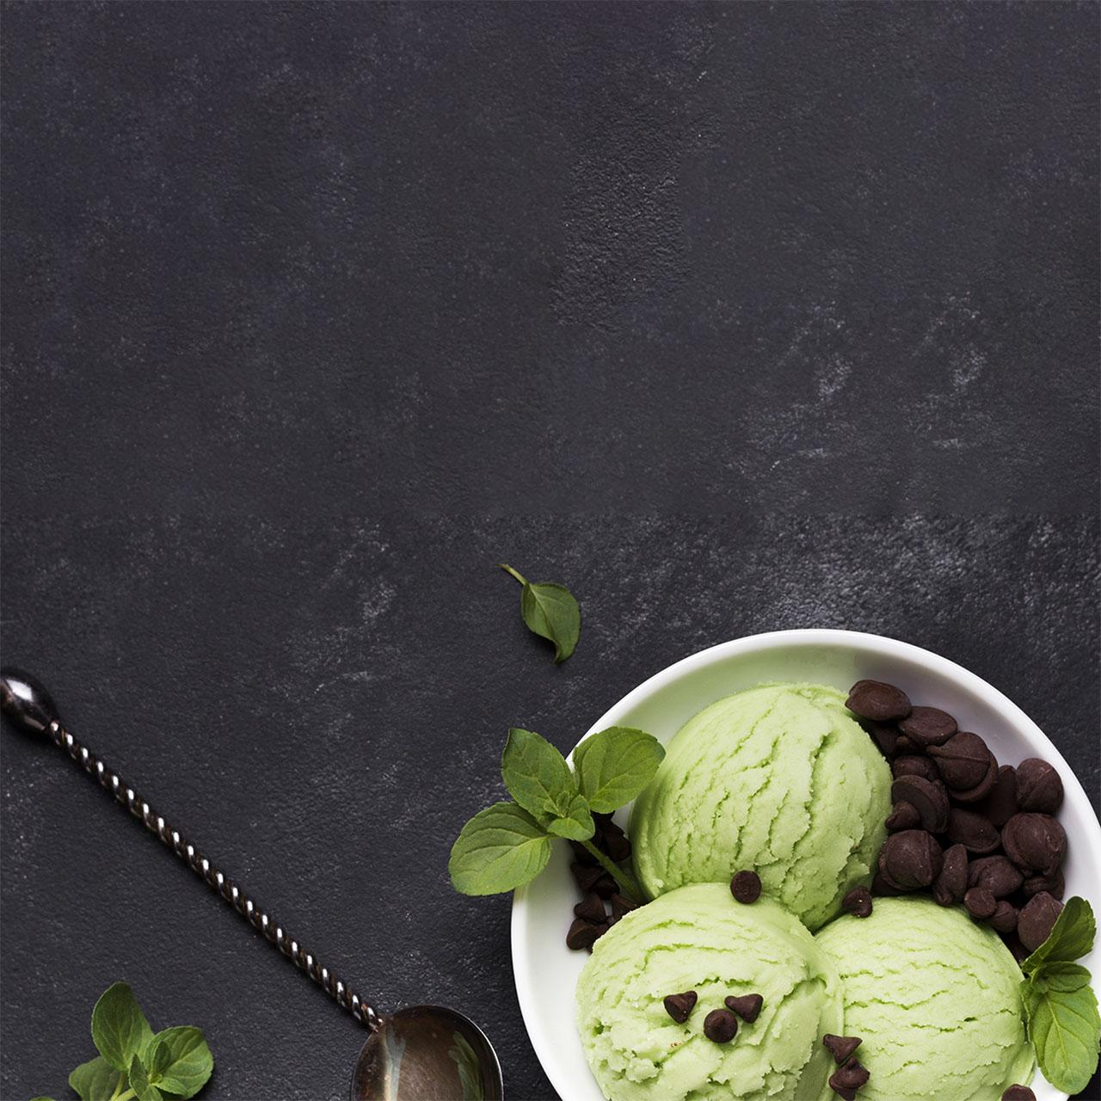
04
Reset

Slide 7
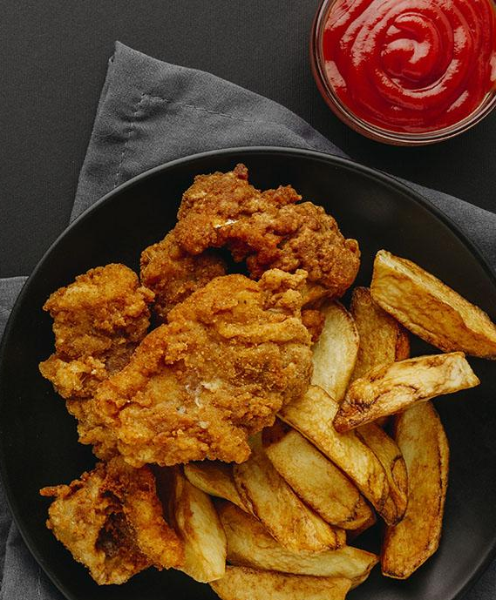
05
PDF

Slide 8
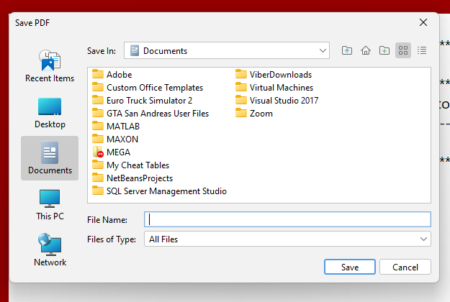
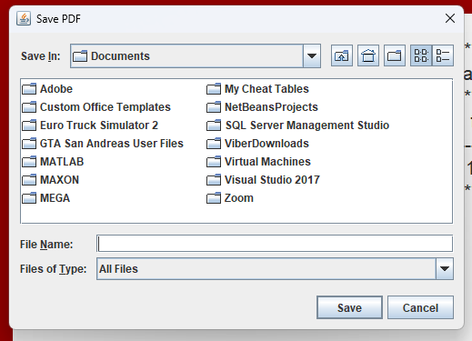
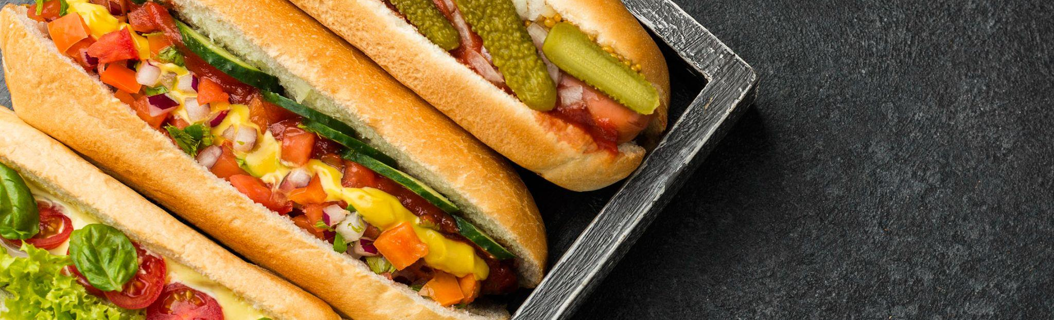
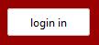
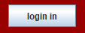
try { UIManager.setLookAndFeel( new FlatLightLaf() ); } catch( Exception ex ) { System.err.println( "Failed to initialize LaF" ); }
06
look and feel windows 11
import com.formdev.flatlaf.FlatLightLaf;

Slide 9
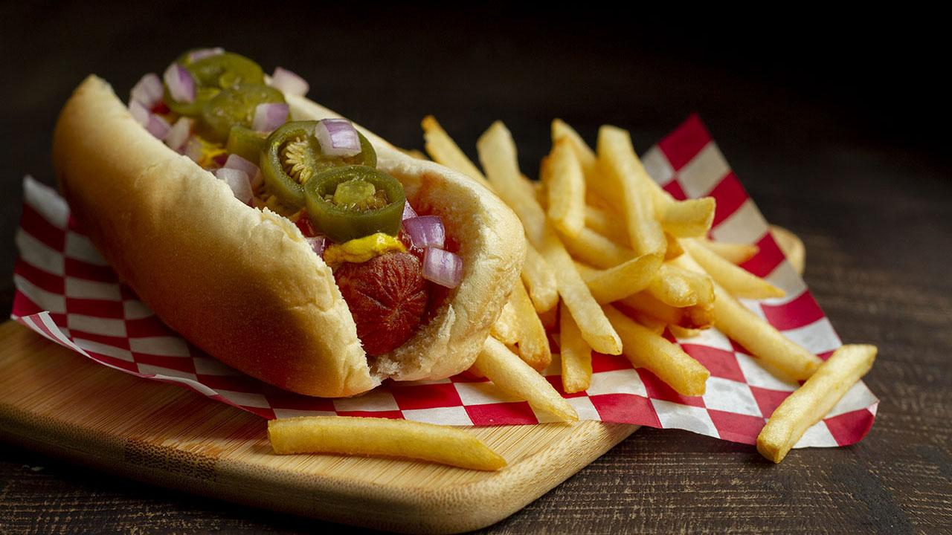
And that is ouer project : Restaurant menu

